Slide 1
Group 14 Check-In #3 FINAL
By T Gwaze, Michael Thomas, Pablo Velazquez, Mohamed Uddin, Malick Dialga

Slide 2
Introduction
PROBLEM
Navigate an unknown 64 × 64 maze with hazards
Hazards rotate every 5 actions
No map provided. Exploration is required
OBJECTIVES
Load maze + hazards
Solve maze-alpha using Q-Learning
Test on maze-beta (no retraining)

Slide 3
Method Justification - Q-Learning
APPROACH HIGHLIGHTS
Natural MDP formulation
Handles unknown transition probabilities
Online learning (explore vs exploit)
ALTERNATIVES REJECTED
Evolutionary: Poor for dynamic hazards
Supervised: Needs pre-collected optimal paths

Slide 4
Environment Setup
API Compliance
Action enum (UP / DOWN / LEFT / RIGHT / WAIT)
TurnResult feedback only
No direct map access
Hazard Mechanics Verified
Death pits : respawn at start
Teleport pads : deterministic destinations
Confusion traps : invert controls
Rotating hazards : 90° every 5 actions

Slide 5
Q-Learning Agent Implementation
Q-Learning Agent
STATE: (x, y, phase, known_walls, known_hazards)
ACTIONS: 5 (UP, DOWN, LEFT, RIGHT, WAIT)
REWARDS:
Goal: +500, Step Penalty: -0.2 , Death: -100
Wall: -2 , New cell found: +5
PARAMETERS:
α = 0.3 (learning rate)
γ = 0.9 (discount)
ε: 1.0 : 0.05 (decay: 0.99 per episode)

Slide 6
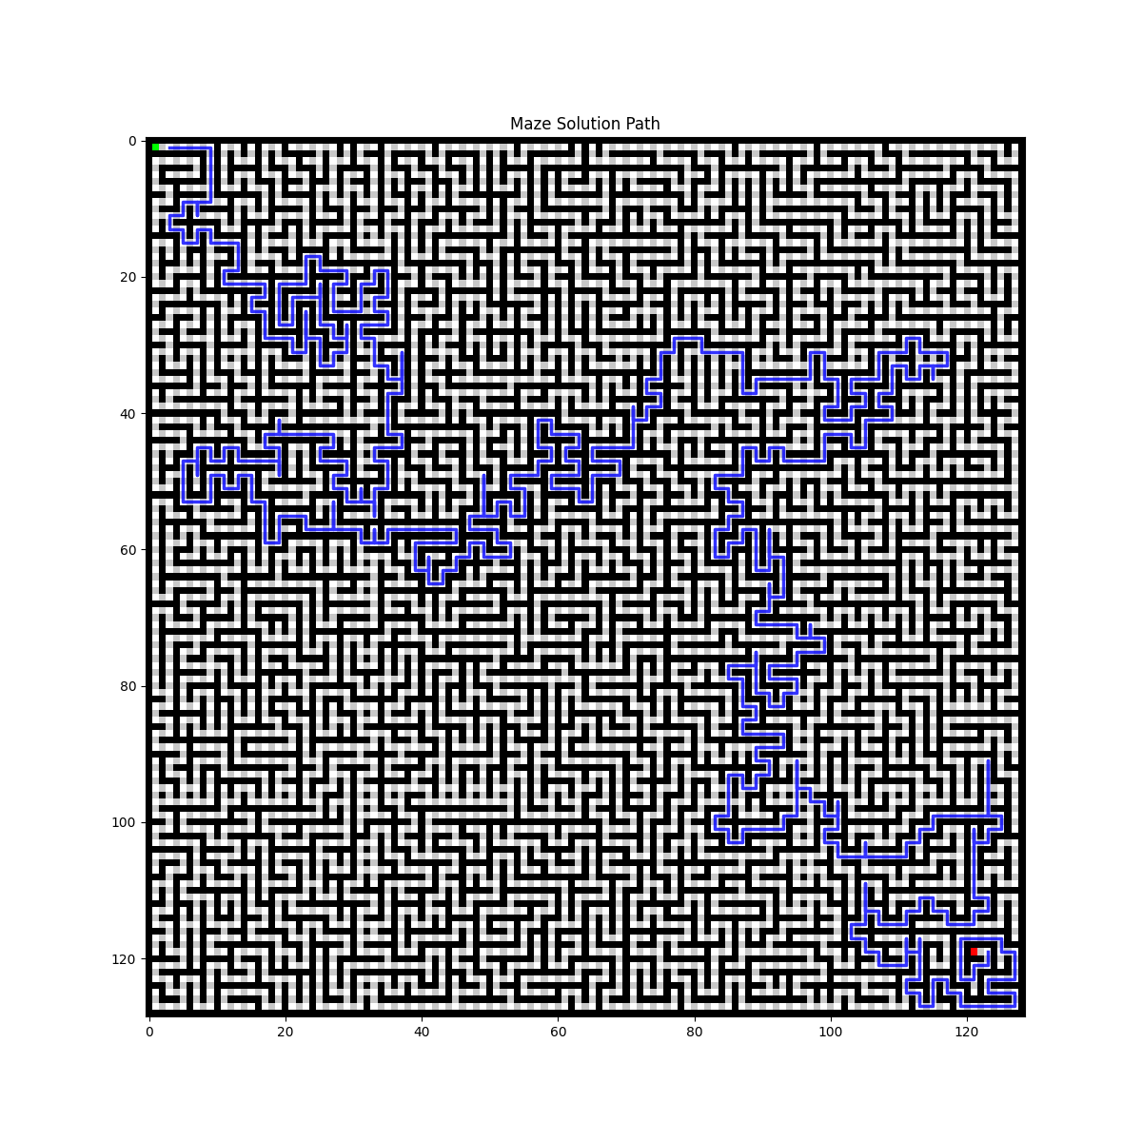
Maze-Alpha Results

Slide 7
Maze-Alpha Results
METRICS:
Training episodes: 500 (with DFS path pre-training)
Q-table size: 1,404 entries
Success rate: 50%
Average turns: 2,746

Slide 8
Testing Results (maze-beta)
METRICS:
Success rate: 100%
Average path length: 1,326.8 cells
Average turns to goal: 1,326.8 turns
Death rate: 0.00

Slide 9
Metrics Analysis & AI Disclosure
KEY FINDINGS:
Q-Learning adapts well to rotating hazards
Transfer to new maze works (100% success)
Death rate low (0.00): safe exploration

Slide 10
Conclusion & Next Steps
Conclusion
Successfully implemented Q-Learning for maze-alpha
Achieved 50% success rate on training maze
Successfully transferred to maze-beta (100%)
Handles rotating hazards via phase-aware state
NEXT STEPS (Extra Credit):
Maze-gamma with multi-directional hazards
Teleport pad integration
Optimize for speed / efficiency competitions

